Slide 1
Midterm REVIEW Jeopardy
APS106

Slide 2
Rules of the GAME
Form a team with your table or tables around you (sizes ~2-4)
Choose a team name for the scoreboard
Go to https://www.multibuzz.app
Enter the Room Code TQCWMG and your Team Name
If you get the answer right, you gain the points, and pick the next category
If you get the answer wrong, you lose the points, and the next person who buzzed in is up
Ask questions if you’re confused! Remember, if you’re confused, so are others!

Slide 3
Panel
THE GOOD, the BAD, and the FUNCTION
File Club
How to Train your While Loop
To output or not to OUTPUT
The Hitchhiker's Guide to Python
$250
$250
$250
$250
$250
$500
$500
$500
$500
$500
$750
$750
$750
$750
$750
$1000
$1000
$1000
$1000
$1000

Slide 4
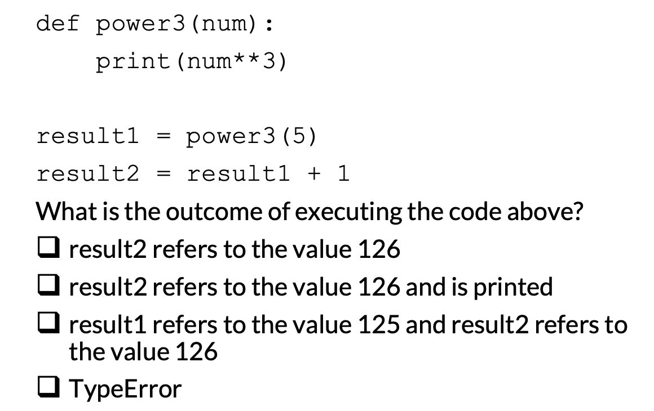
What is the result?
THE GOOD, the BAD, and the FUNCTION · $250
Question board

Slide 5
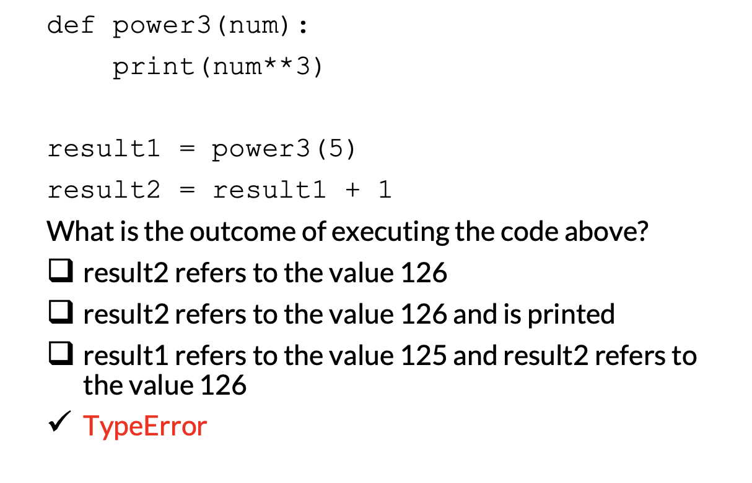
THE GOOD, the BAD, and the FUNCTION · $250
Question board

Slide 6
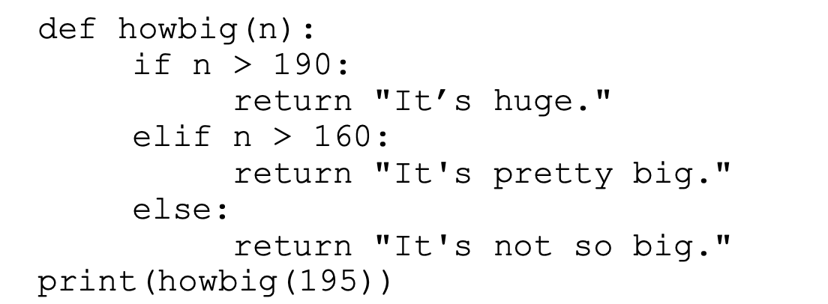
What is the output?
THE GOOD, the BAD, and the FUNCTION · $500
Question board

Slide 7
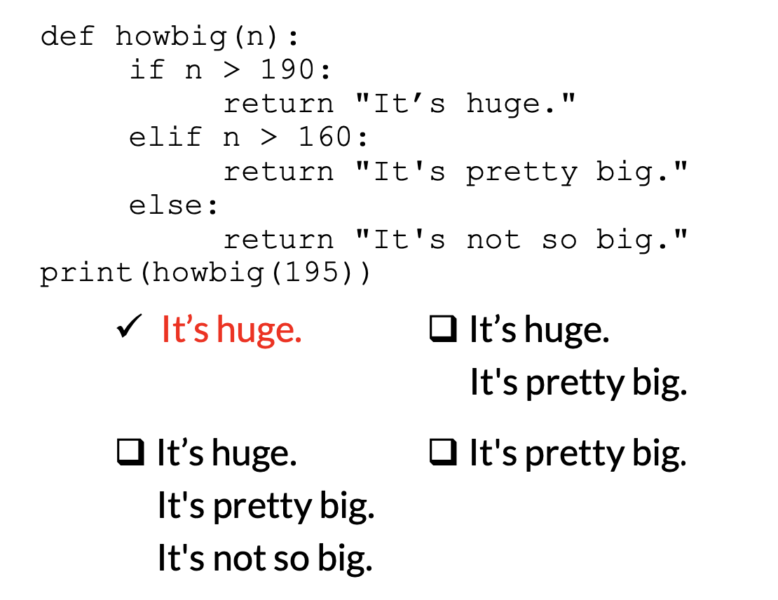
THE GOOD, the BAD, and the FUNCTION · $500
Question board

Slide 8
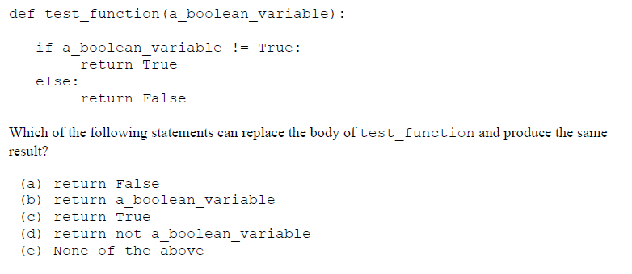
THE GOOD, the BAD, and the FUNCTION · $750
Question board

Slide 9
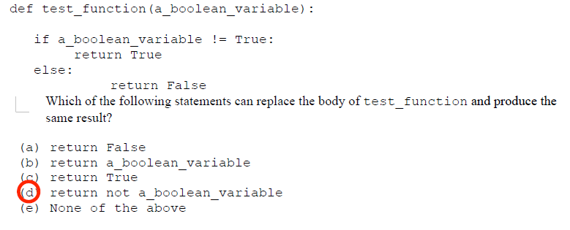
THE GOOD, the BAD, and the FUNCTION · $750
Question board

Slide 10
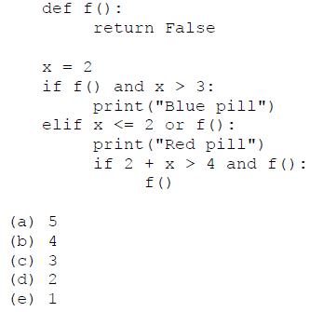
How many times in total is the function f() called?
THE GOOD, the BAD, and the FUNCTION · $1000
Question board

Slide 11
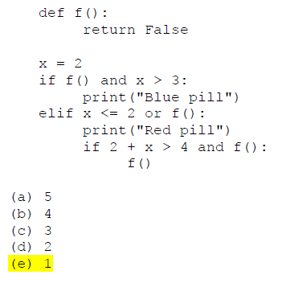
THE GOOD, the BAD, and the FUNCTION · $1000
Question board

Slide 12
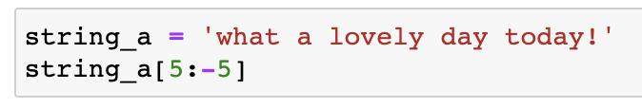
What is the output?
File Club · $250
Question board

Slide 13
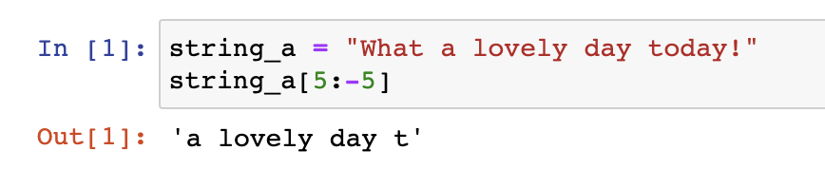
File Club · $250
Question board

Slide 14
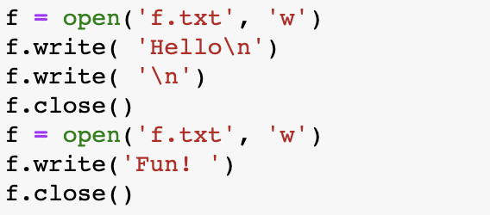
What is the result in the f.txt file?
File Club · $500
a) Fun!
c) Hello
Fun!
b) ‘Hello’
‘Fun!’
d) ‘Hello Fun!’
Question board

Slide 15
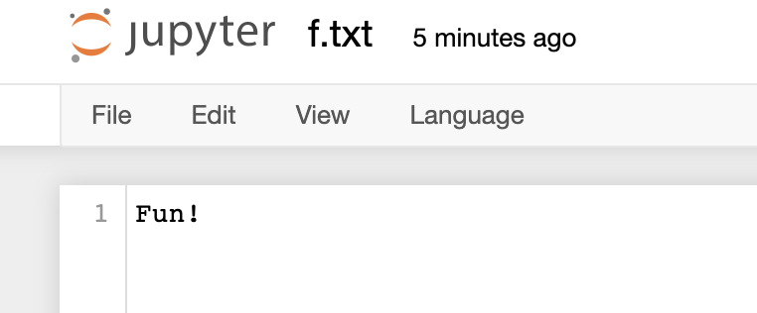
What is the result in the f.txt file?
File Club · $500
a) Fun!
Question board

Slide 16
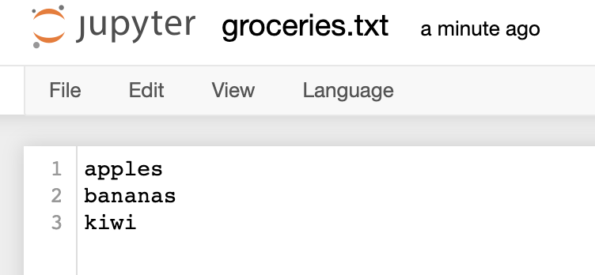
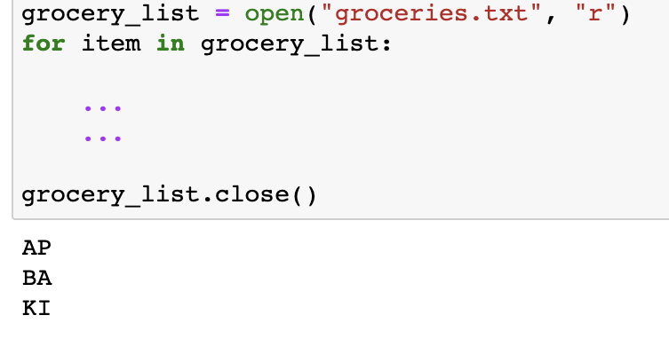
How do you print out the first two characters upper-case per item?
File Club · $750
Question board

Slide 17
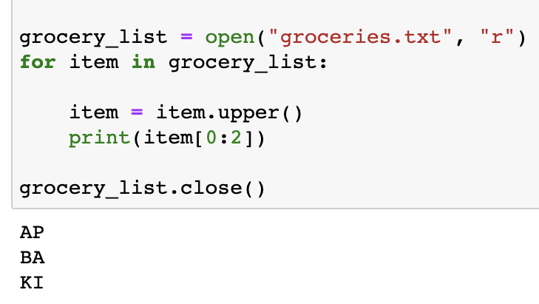
How do you print out the first two characters upper-case per item?
File Club · $750
Question board

Slide 18
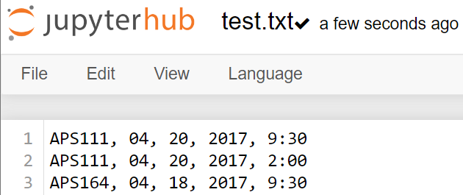
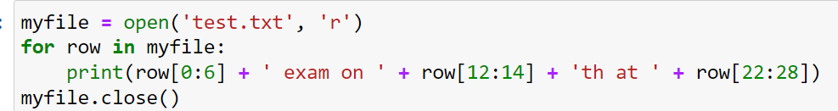
What is the output?
File Club · $1000
Question board

Slide 19
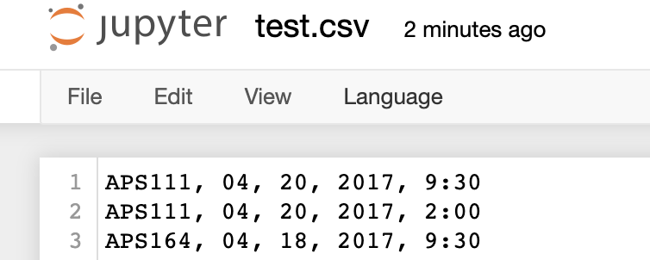
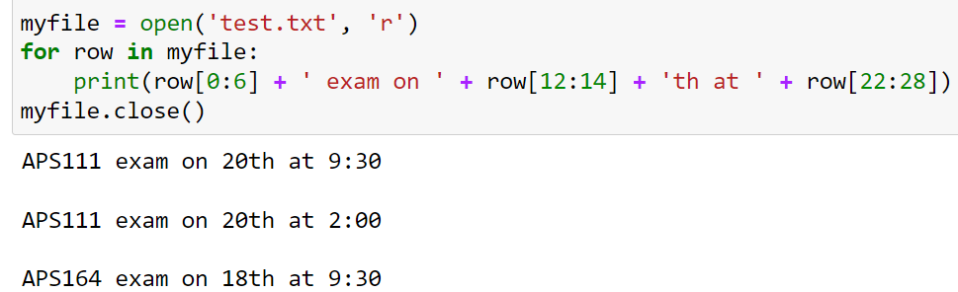
File Club · $1000
Question board

Slide 20
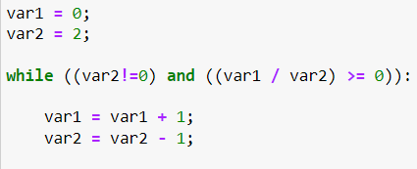
What are the values of var 1 and var 2 after the following code segment is executed and the while loop finishes?
How to Train Your While Loop · $250
Question board
Notes:
Go to python notebook

Slide 21
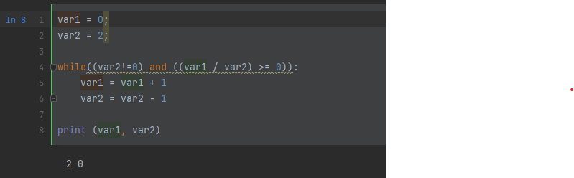
What are the values of var 1 and var 2 after the following code segment is executed and the while loop finishes?
How to Train Your While Loop · $250
Question board
Notes:
Go to python notebook

Slide 22
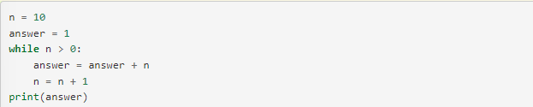
What will this code print?
How to Train Your While Loop · $500
Question board

Slide 23
What will this code print?
How to Train Your While Loop · $500
Nothing! Infinite loop!
Question board

Slide 24
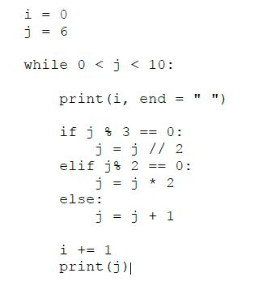
What will the code print?
How to Train Your While Loop · $750
Question board

Slide 25
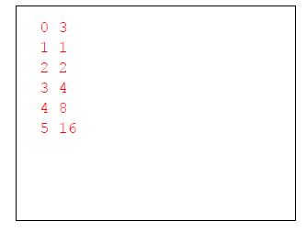
What will the code print?
How to Train Your While Loop · $750
Question board

Slide 26
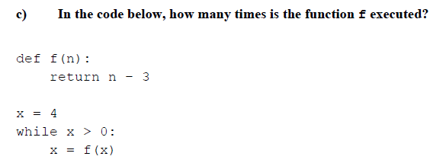
How to Train Your While Loop · $1000
Question board
Notes:
2

Slide 27
How to Train Your While Loop · $1000
2
Question board
Notes:
2

Slide 28
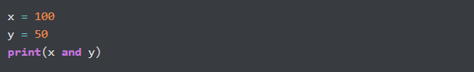
What is the output?
To output or not to OUTPUT · $250
Question board

Slide 29
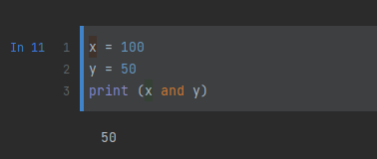
What is the output?
To output or not to OUTPUT · $250
Question board

Slide 30
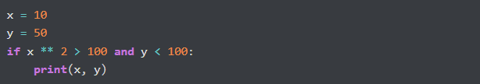
What is the output?
To output or not to OUTPUT · $500
Question board
Notes:
No output

Slide 31
What is the output?
To output or not to OUTPUT · $500
Nothing!
Question board
Notes:
No output

Slide 32
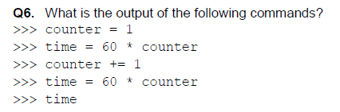
To output or not to OUTPUT· $750
Question board
Notes:
120

Slide 33
To output or not to OUTPUT· $750
120
Question board
Notes:
120

Slide 34
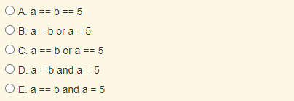
Which of the following evaluates to True when a is equal to b or when a is equal to 5?
To output or not to OUTPUT · $1000
Question board
Notes:
C

Slide 35
Which of the following evaluates to True when a is equal to b or when a is equal to 5?
To output or not to OUTPUT · $1000
Question board
Notes:
C

Slide 36
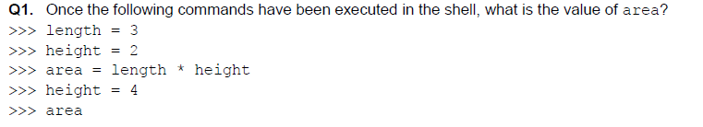
The Hitchhiker's Guide to Python · $250
Question board
Notes:
6

Slide 37
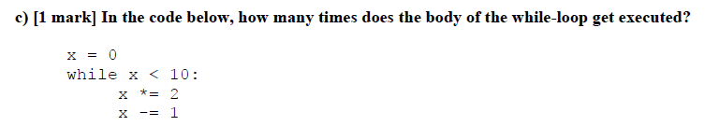
The Hitchhiker's Guide to Python · $500
Question board
Notes:
Infinite

Slide 38
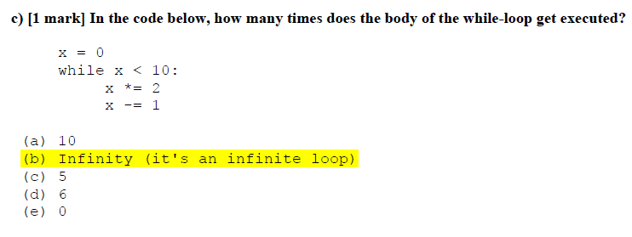
The Hitchhiker's Guide to Python · $500
Question board
Notes:
Infinite

Slide 39

The Hitchhiker's Guide to Python · $750
a. – (7 % 4) b. 2 ** 3 c. 6 / 2 d. 3
e. 6.0
Question board

Slide 40
The Hitchhiker's Guide to Python · $750
a. – (7 % 4) b. 2 ** 3 c. 6 / 2 d. 3
e. 6.0
Question board

Slide 41
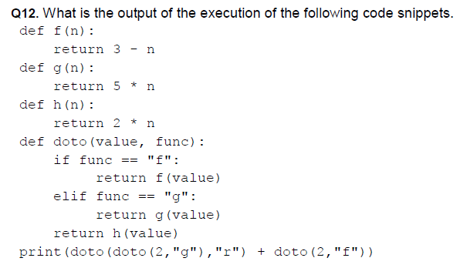
The Hitchhiker's Guide to Python · $1000
Question board
Notes:
21

Slide 42
The Hitchhiker's Guide to Python · $1000
21
Question board
Notes:
21

Slide 43
Final Jeopardy

Slide 44
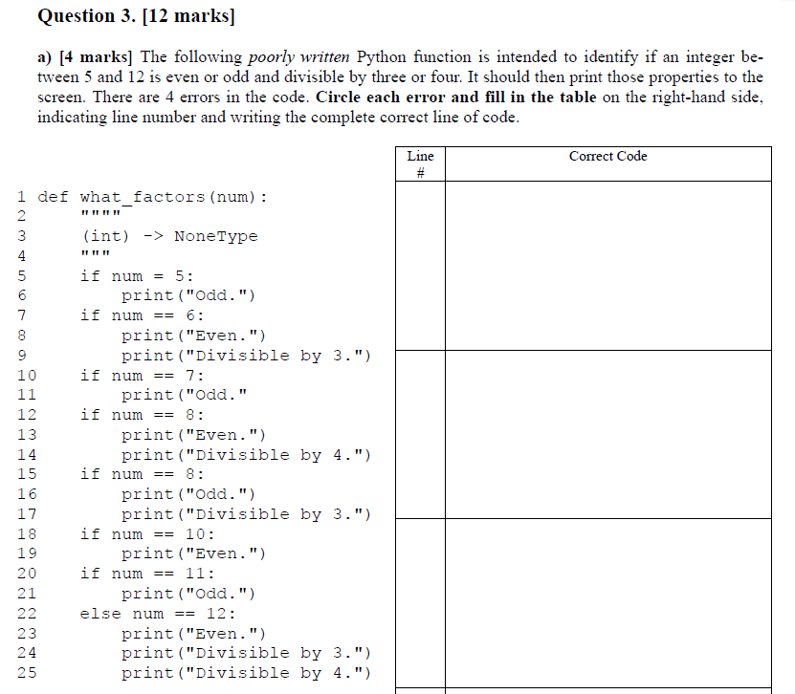
Question 1 · FINAL JEOPARDY

Slide 45
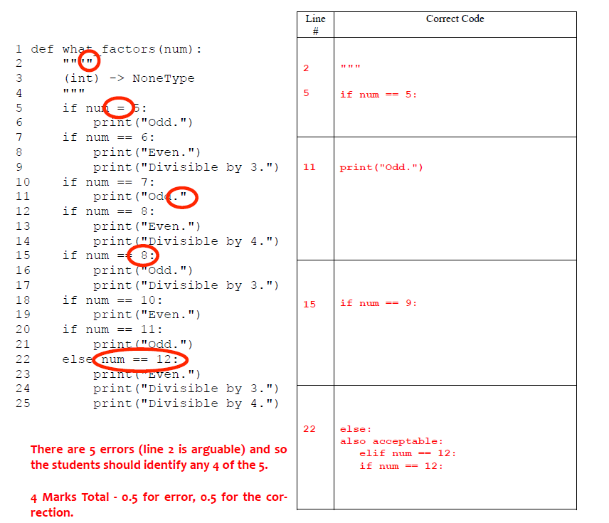
Question 1· FINAL JEOPARDY

Slide 46
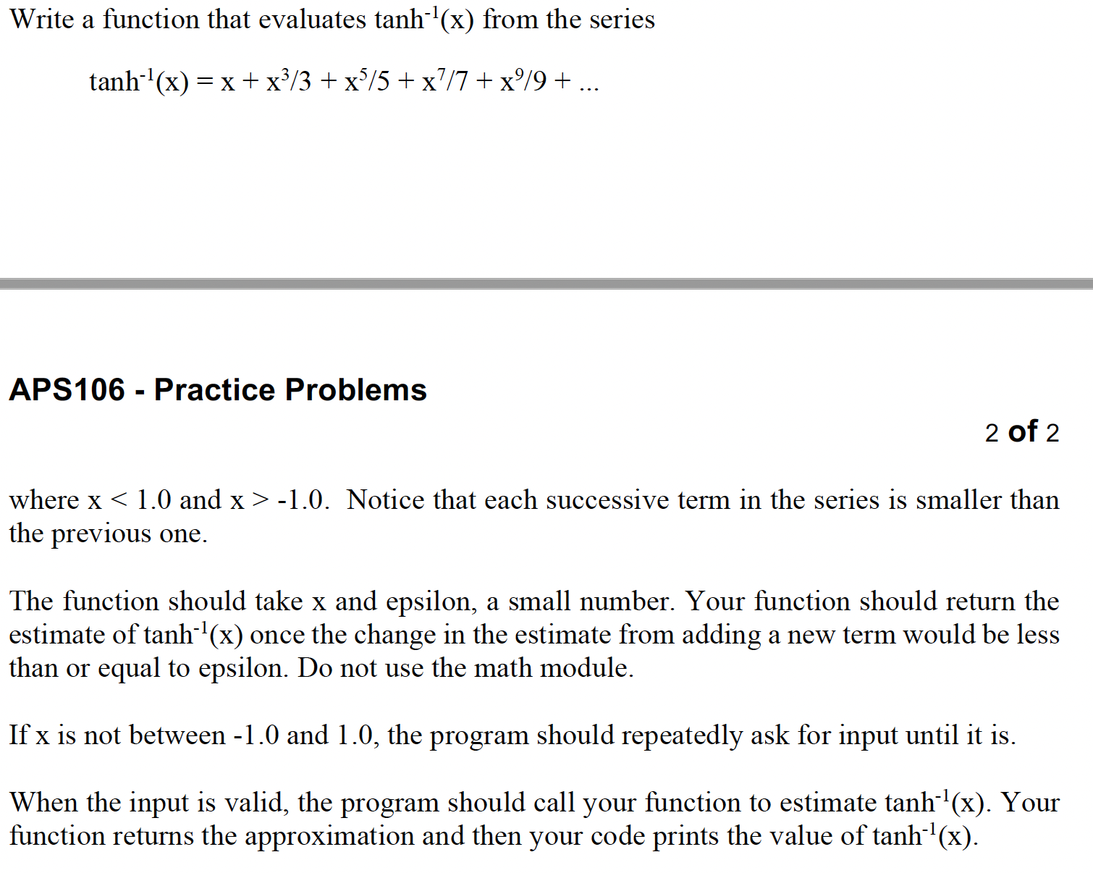
Question 2 · FINAL JEOPARDY

Slide 47
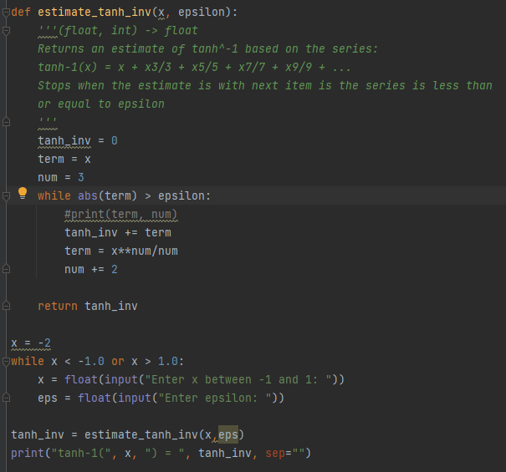
Question 2 · FINAL JEOPARDY

